Slide 1



Funded by the European Union. Views and opinions expressed are however those of the author(s) only and do not necessarily reflect those of the European Union or the European Education and Culture Executive Agency (EACEA). Neither the European Union nor EACEA can be held responsible for them.

Slide 2


Module 2
Facilitating and Moderating Online Intercultural Dialogue
D3.2 Facilitator Training Package

Slide 3

Why this module matters
• A good design still needs good facilitation.
• Facilitators protect the learning space and guide the process.
• Intercultural dialogue can include silence, tension, misunderstanding and strong emotions.
• The final output is a facilitation scenario response and personal checklist.

Slide 4
Learning outcomes
• Describe the role of the online facilitator.
• Create safe and inclusive group agreements.
• Use techniques that include quieter participants and manage dominant voices.
• Respond to conflict and harmful comments.
• Debrief dialogue and connect it to learning recognition.

Slide 5
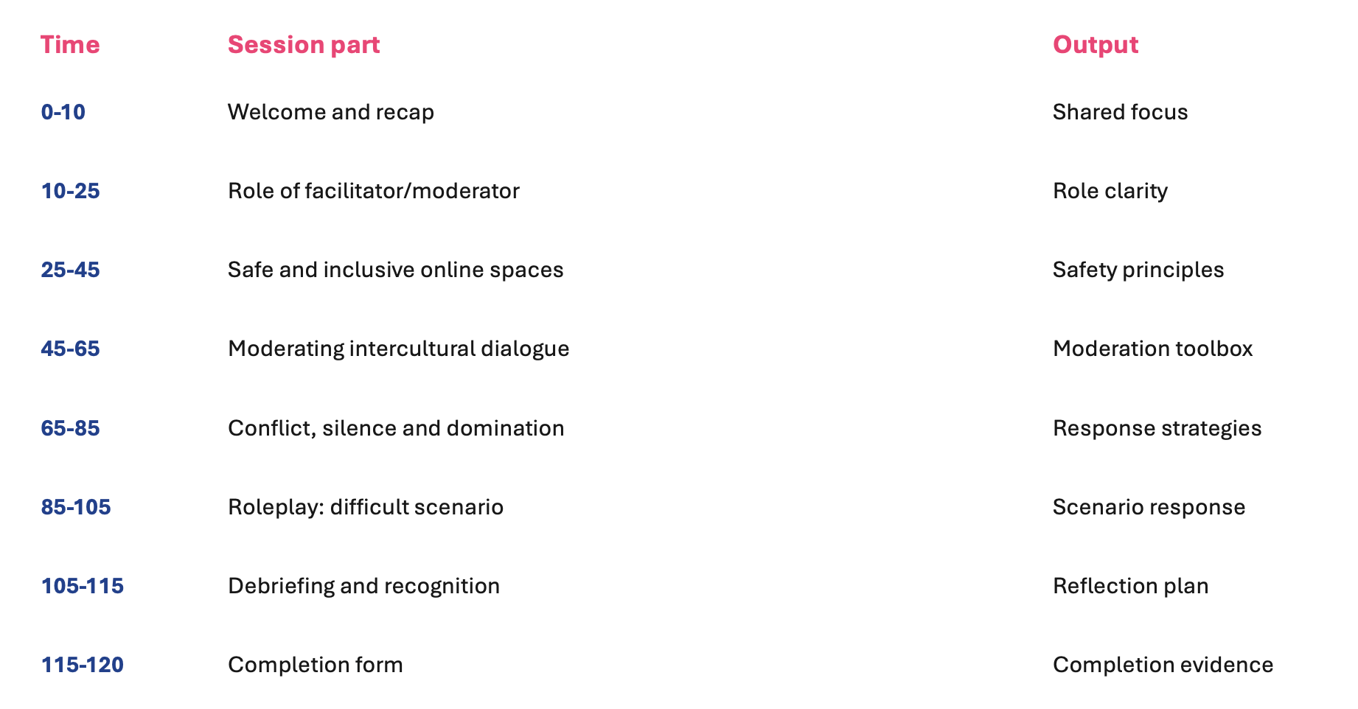
Two-hour module agenda

Slide 6
The facilitator role
• Hold the process, not all the answers.
• Clarify purpose, timing and participation rules.
• Notice who is speaking and who is absent.
• Protect participants from harmful behaviour.
• Connect activities with learning outcomes.

Slide 7
Roles in an online session
Visible roles
Hidden responsibilities
• Facilitator
• Safety monitoring
• Co-facilitator
• Chat monitoring
• Technical host
• Accessibility support
• Participants
• Evidence tracking
• Timekeeper
• Follow-up

Slide 8
Creating safe online spaces
• Welcome participants by name where possible.
• Explain the purpose and limits of the space.
• Co-create group agreements.
• Clarify confidentiality and recording rules.
• Make participation options visible: voice, chat, reactions, shared notes.

Slide 9
Suggested group agreements
• Listen to understand, not only to reply.
• Speak from personal experience.
• Respect different perspectives while challenging harmful statements.
• Use simple language and avoid assumptions.
• Participants may pass, but everyone is invited to contribute.

Slide 10
Inclusive participation techniques
• Round robin: everyone gets a short turn.
• Think-write-share: reflection before speaking.
• Chat harvesting: collect written ideas.
• Small groups: lower pressure interaction.
• Anonymous poll: surface opinions safely.

Slide 11
Moderation techniques
• Ask open questions.
• Summarize and bridge between points.
• Reframe unclear or tense comments.
• Name patterns in the discussion.
• Bring the group back to the learning purpose.

Slide 12
Handling silence
• Do not fill every silence immediately.
• Give participants time to think or write.
• Offer a low-pressure prompt in chat.
• Use pairs or small groups before plenary.
• Check whether the question was clear.

Slide 13
Managing dominant voices
• Thank the participant for their contribution.
• Set a structure: one minute per person.
• Invite voices that have not yet spoken.
• Use chat or shared boards for parallel input.
• Speak privately if the behaviour continues.

Slide 14
Responding to conflict
• Pause the conversation.
• Clarify what was said and its impact.
• Return to group agreements.
• Protect affected participants.
• Reframe toward learning without ignoring harm.

Slide 15
Responding to discriminatory comments
• Address it immediately and calmly.
• Name the issue without attacking the person.
• State that harmful language is not acceptable.
• Offer correction and learning.
• Follow escalation procedures if needed.

Slide 16
Intercultural humility
• Avoid treating one participant as representative of a whole culture.
• Ask, do not assume.
• Make space for complexity and difference.
• Recognize power dynamics, language confidence and digital access.
• Accept that mistakes can become learning moments when handled well.

Slide 17
Scenario roleplay instructions
• Each group receives one scenario card.
• Choose one person as facilitator, one as participant, one as observer.
• Roleplay for five minutes.
• Debrief for five minutes.
• Prepare one practical response strategy.

Slide 18
Scenario cards
• Silence after a sensitive question.
• One participant dominates the discussion.
• A cultural misunderstanding escalates.
• A discriminatory comment is posted in chat.
• A participant is excluded because of technical problems.

Slide 19
Observer checklist
• Did the facilitator pause and clarify?
• Did they protect the group?
• Did they invite quieter voices?
• Did they connect back to the purpose?
• Did they close with reflection or next steps?

Slide 20
Debriefing model
• What happened?
• What did we notice or feel?
• What did we learn?
• How does this connect to virtual exchange facilitation?
• What will we apply next time?

Slide 21
Learning recognition
• End with reflection, not only thanks.
• Ask participants to name one learning point.
• Use completion forms to document participation.
• Offer certificate or recognition text where relevant.
• Archive evidence for reporting.

Slide 22
Self-paced adaptation
• Upload scenario cards and this presentation.
• Ask participants to choose one scenario and write a response.
• Use the quiz and reflection form as completion evidence.
• Invite optional peer exchange through a shared forum or padlet-style board.

Slide 23
Module 2 completion
• Submit one facilitation scenario response.
• Complete the Module 2 quiz and reflection form.
• Download the personal facilitation checklist.
• Use the materials to facilitate future DigiCreate virtual exchanges.

Slide 24
Final reflection
• Which facilitation challenge is most relevant to your work?
• What phrase could you use to interrupt harm respectfully?
• How will you include quieter participants?
• What will you add to your personal facilitation checklist?

Slide 25
THANK YOU
• DigiCreate Facilitator Training
• Module 2: Facilitating and Moderating Online Intercultural Dialogue
• Use the resources page for manual, templates, forms and checklists.

