Slide 1



Funded by the European Union. Views and opinions expressed are however those of the author(s) only and do not necessarily reflect those of the European Union or the European Education and Culture Executive Agency (EACEA). Neither the European Union nor EACEA can be held responsible for them.

Slide 2


Module 1
Designing and Preparing a Virtual Exchange Project
D3.2 Facilitator Training Package

Slide 3

Why this module matters
A virtual exchange is more than an online meeting.Sublevel
It needs a clear learning purpose, interaction design, facilitation and evidence.
Good preparation reduces technical, intercultural and participation risks.
The final output is a Mini Virtual Exchange Plan.

Slide 4
Learning outcomes
Define what makes virtual exchange different from a webinar.
Write practical learning outcomes for online intercultural interaction.
Map a participant journey before, during and after the exchange.
Select tools that support access, safety and collaboration.
Create a preparation checklist and completion evidence plan.

Slide 5
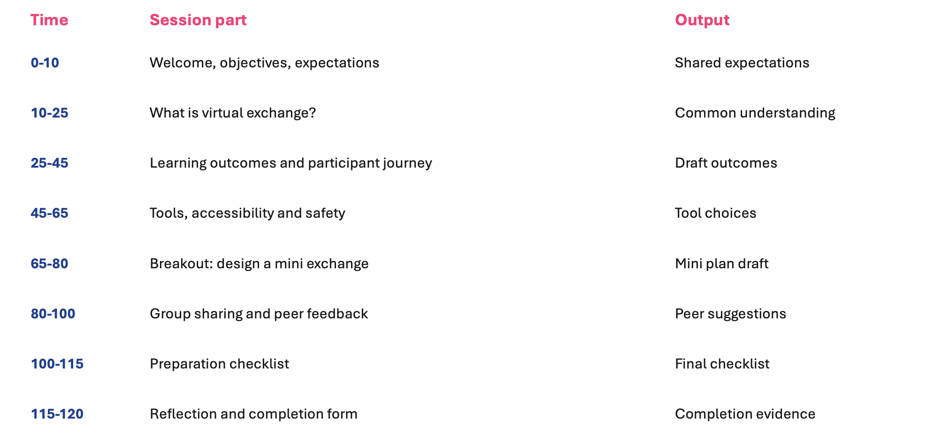
Two-hour module agenda

Slide 6
Core definition
• Virtual exchange connects participants from different countries or cultures through structured online interaction.
• It combines facilitation, dialogue, collaboration and reflection.
• It can be embedded in youth work, higher education or non-formal learning.
• Participants should not only receive content; they should meet, discuss and create meaning together.

Slide 7
Webinar vs virtual exchange
Webinar
Virtual exchange
• Mainly one-way delivery
• Facilitated dialogue
• Limited peer interaction
• Small-group interaction
• Success measured by attendance
• Success measured by learning and exchange
• Useful for information sharing
• Useful for intercultural competence

Slide 8
Start with learning outcomes
• What should participants understand?
• What should they be able to do?
• What attitude or awareness should change?
• What evidence will show that learning happened?

Slide 9
Participant journey
• Before: invitation, registration, onboarding and expectations.
• Opening: welcome, trust-building and ground rules.
• Exchange: structured dialogue and collaboration.
• Reflection: debrief, learning recognition and feedback.
• After: resources, follow-up and evidence archive.

Slide 10
Design principle: interaction first
• Use short input and longer exchange time.
• Choose tasks that require participants to speak, write, decide or create together.
• Move from individual reflection to pair or group dialogue.
• Close every activity with learning reflection.

Slide 11
Digital tools should serve learning
• Video conferencing for live contact.
• Shared documents for co-creation.
• Whiteboards for mapping and brainstorming.
• Forms for registration, quizzes and completion.
• Chat and polls for low-pressure participation.

Slide 12
Accessibility checklist
• Keep tools simple and browser-based where possible.
• Offer instructions before the session.
• Avoid requiring high bandwidth for every task.
• Use captions or written summaries where possible.
• Offer alternatives for participants who cannot speak or use camera.

Slide 13
Safety and data protection basics
• Do not record without clear consent.
• Explain how registration data will be used.
• Set group agreements before discussion.
• Use waiting rooms or registration lists where needed.
• Prepare an escalation plan for harmful behaviour.

Slide 14
Mini Virtual Exchange Plan
• Target group and countries involved.
• Topic and intercultural purpose.
• Learning outcomes.
• Interaction method and timing.
• Digital tools and accessibility measures.
• Facilitator roles and completion evidence.

Slide 15
Breakout task instructions
• Work in groups of three to five.
• Use the Design Canvas from the workbook.
• Choose one realistic virtual exchange idea.
• Prepare a two-minute presentation.
• Identify one risk and one mitigation measure.

Slide 16
Peer feedback method
• One strength: what works well?
• One question: what needs clarification?
• One suggestion: what would improve inclusion or interaction?
• Keep feedback specific, respectful and brief.

Slide 17
Preparation checklist
• Agenda and timing confirmed.
• Links, tools and backup channels tested.
• Participant instructions sent.
• Accessibility needs checked.
• Forms and evidence tracking ready.
• Facilitator and technical support roles clear.

Slide 18
Evidence for reporting
• Registration form = enrolled participants.
• Completion form = completed participants.
• Quiz and reflection = engagement evidence.
• Attendance list and platform analytics = supporting evidence.
• Completion rate = completed / enrolled x 100.

Slide 19
Common design mistakes
• Starting with the tool instead of the learning outcome.
• Planning too much content and too little interaction.
• Ignoring accessibility and time-zone barriers.
• Not preparing group agreements or safety rules.
• Forgetting completion evidence.

Slide 20
Self-paced adaptation
• Upload this presentation and the Design Canvas.
• Provide a short introduction text on the platform.
• Ask participants to complete the quiz and reflection form.
• Use the completion form to record module completion.

Slide 21
Final reflection
• What is one design principle you will apply?
• Which tool will support your learning outcome?
• What risk do you need to prepare for?
• What evidence will show that participants completed the module?

Slide 22
Module 1 completion
• Submit the Mini Virtual Exchange Plan.
• Complete the Module 1 quiz and reflection form.
• Download the preparation checklist.
• Move to Module 2 when ready to practice facilitation.

Slide 23
Final reflection
• What is one design principle you will apply?
• Which tool will support your learning outcome?
• What risk do you need to prepare for?
• What evidence will show that participants completed the module?

Slide 24
THANK YOU
• DigiCreate Facilitator Training
• Module 1: Designing and Preparing a Virtual Exchange Project
• Next module: Facilitating and Moderating Online Intercultural Dialogue

